Slide 1
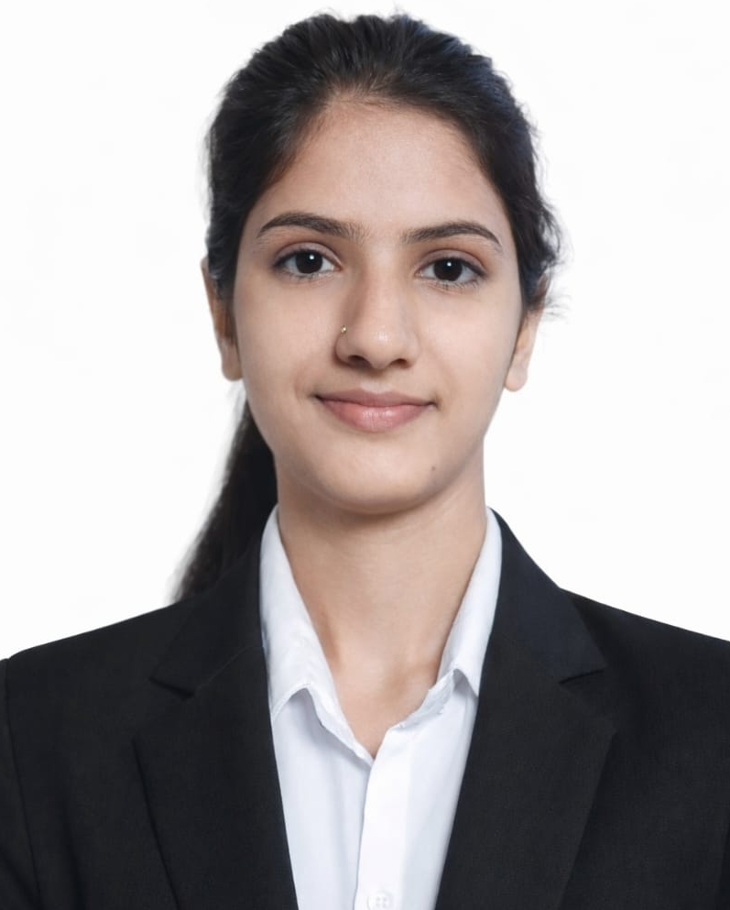
Hi everyone . I’m Sheetal Sharma, a data analyst
Today I’ll presenting a power bi project that I have crafted during my learning journey without delay, let explore it together!

Slide 2
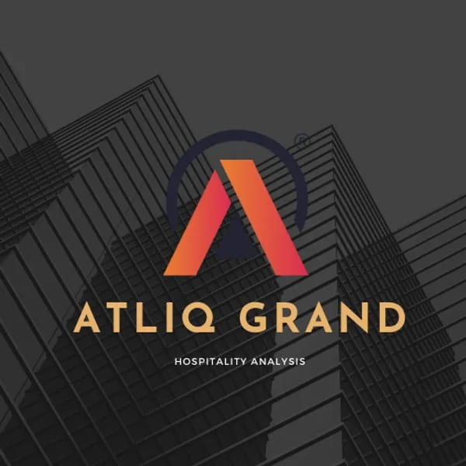




1. COMPANY OVERVIEW
2. BUSINESS MODEL
3. PROBLEM STATEMENT
4. DASHBOARD
5. INSIGHTS AND RECOMMENDATION
AGENDA
Notes:
Agenda

Slide 3

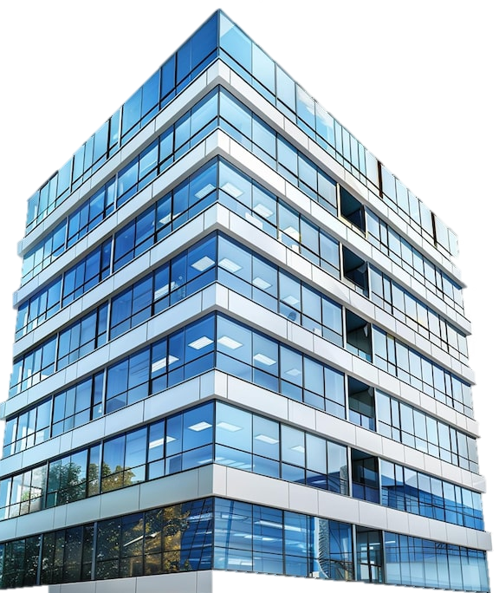

company OVERVIEW
Atliq Grand is a leading player in India’s hospitality sector , it owns a chain of five-star hotels in major
Indian cities like Bangalore, Delhi, Mumbai and Hyderabad. Specializing in both business and luxury
accommodations, each property offers a divers range of room classes tailored to meet the different
needs of its guests.

Slide 4
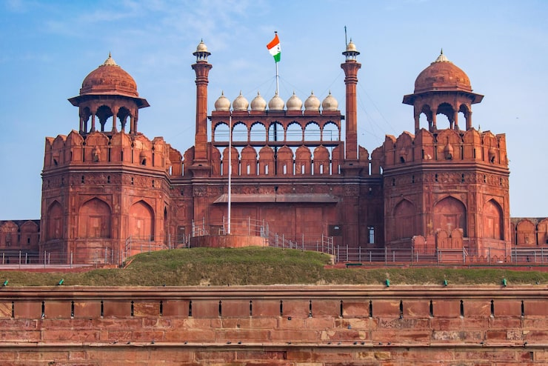
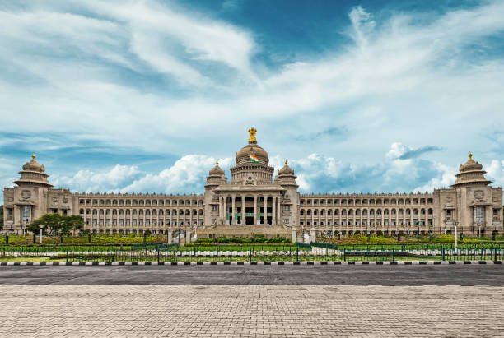
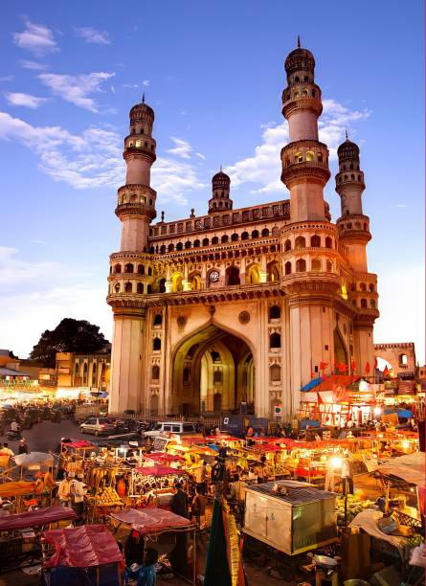
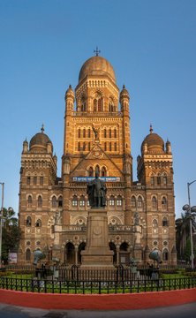
ATLIQ GRAND
Delhi
Bangalore
Hyderabad
Mumbai

Slide 5
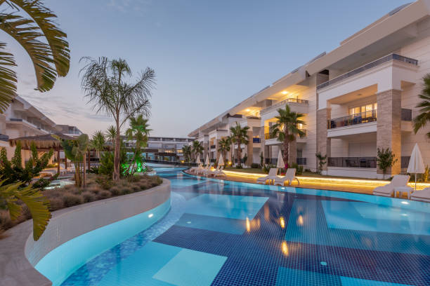
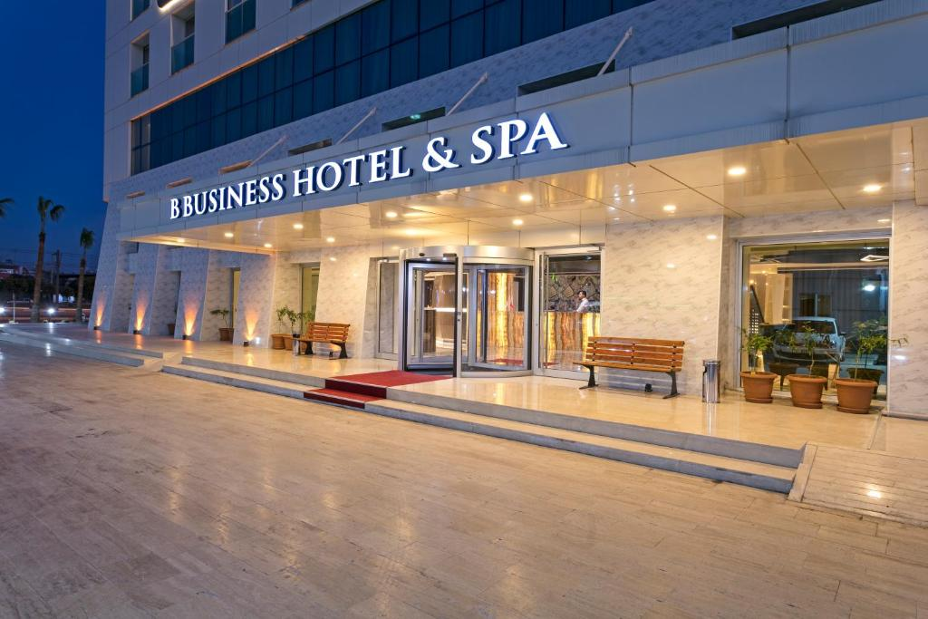
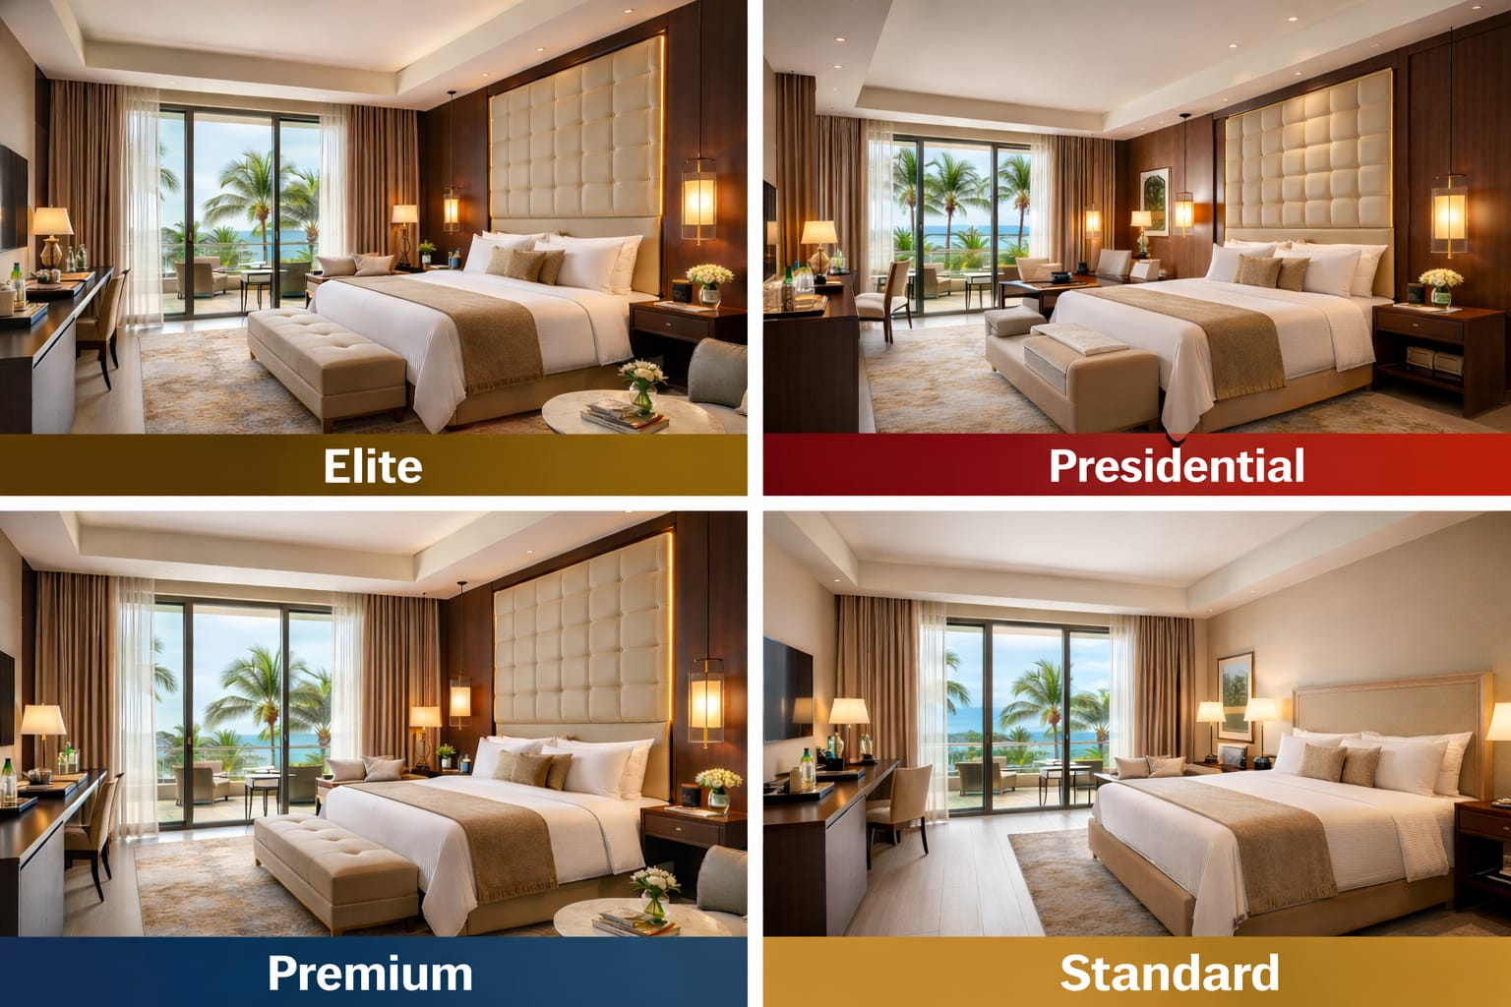
Business Hotel
Luxury Hotel
Room Class

Slide 6

Problem statement
Atliq Grands, a renowned player in the luxury/business hotel industry of India for the past two decades, faces a critical challenge. Despite their longstanding presence, they’re experiencing a decline in market share and revenue due to competition and management decisions. To reverse this trend, they seek to implement ‘Business and Data Intelligence. 'Without an in-house team, they plan to hire a third-party service provider for insights from their historical data.

Slide 7
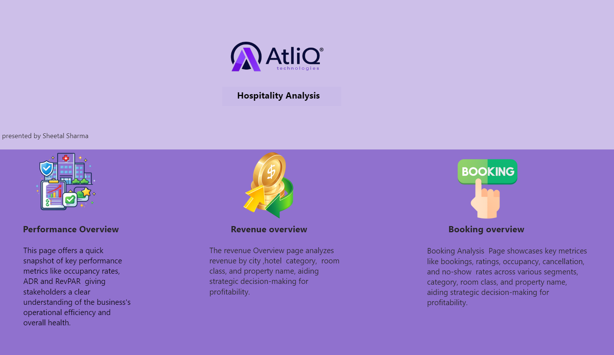

Slide 8
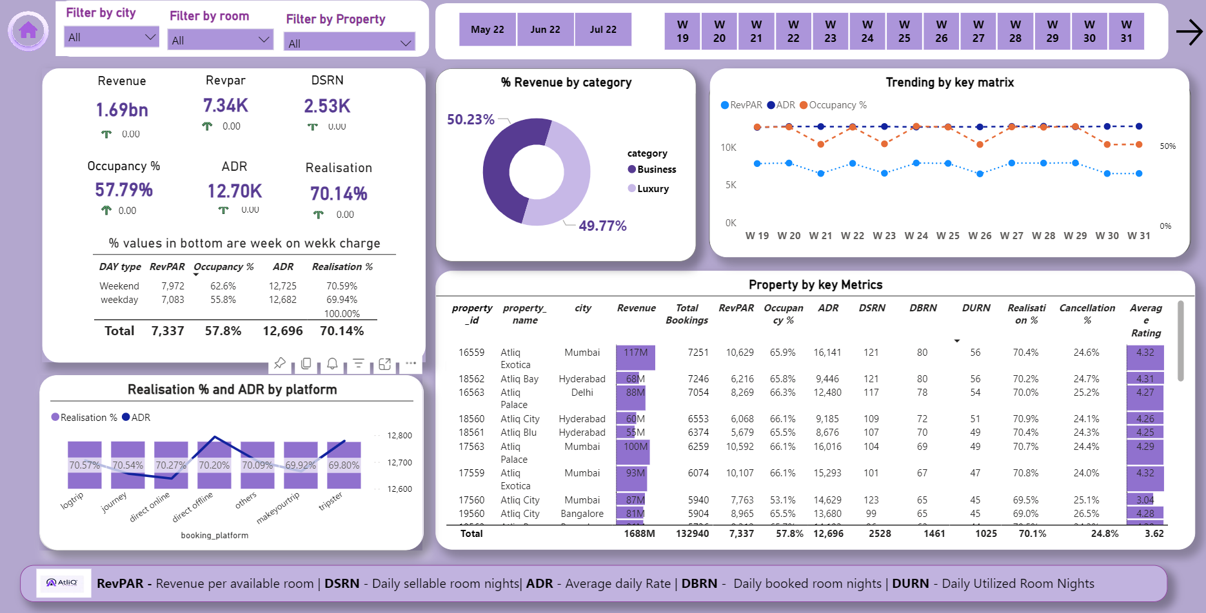

Slide 9
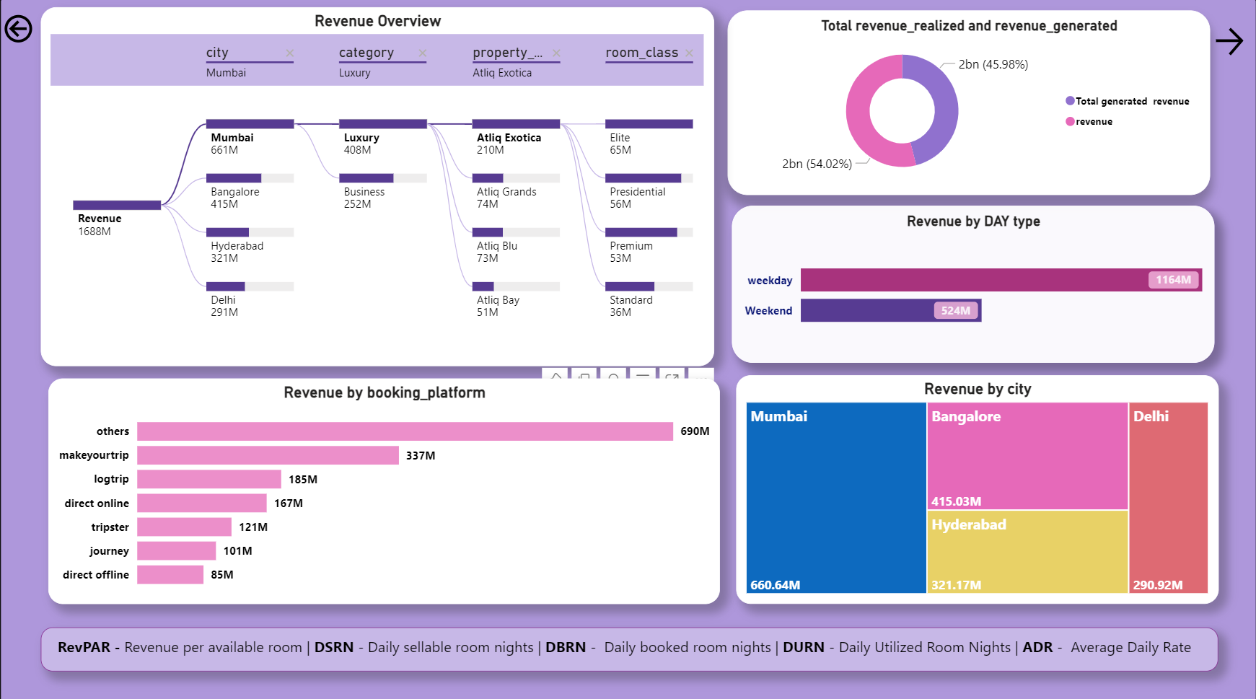

Slide 10
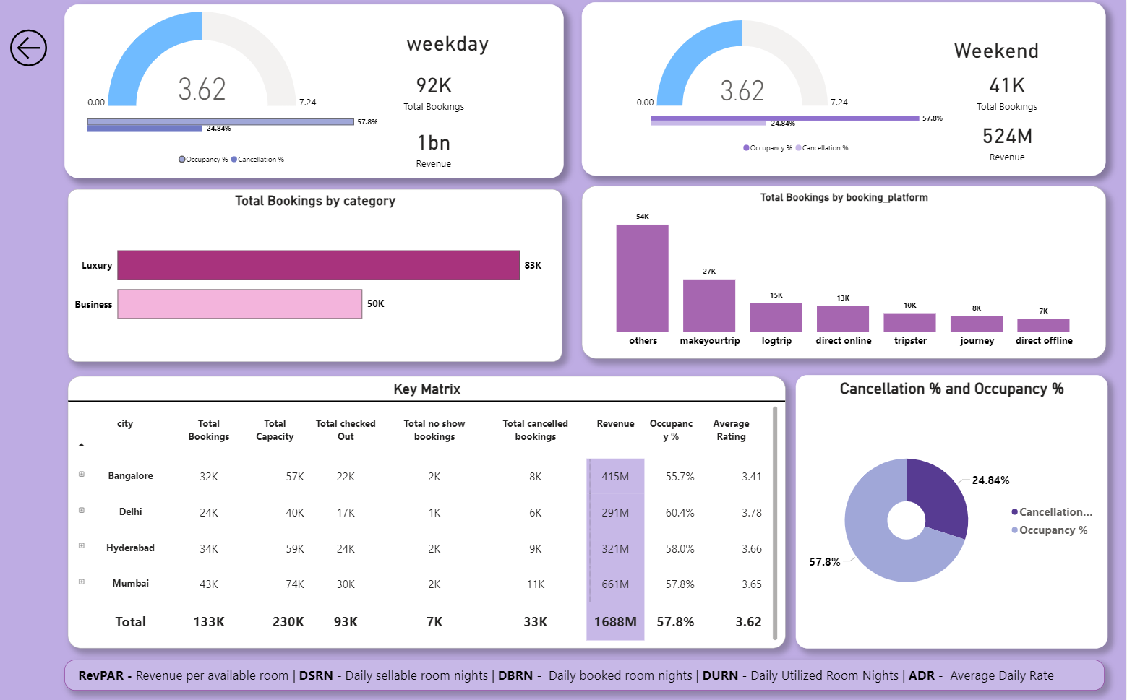

Slide 11
INSIGHT
Mumbai leads in revenue generation among all cities, with an impressive total of 669 million rupees.
Despite achieving the highest average rating, Delhi registered the lowest revenue of 290 million.
A significant portion of the revenue is derived from luxury hotels.
MakeMyTrip recorded the second highest number of bookings among all booking platforms .
AtliQ Exotica and AtliQ Palace are the top contributors to revenue, accounting for 18.75% and 17.80% respectively. Both boast solid average ratings of 3.62 and 3.75, indicating their quality performance.
Weekdays command the highest revenue, totalling 1.16 billion rupees.
Elite and premium rooms are the primary revenue generators among all room class types.

Slide 12
RECOMMENDATION
Bangalore's revenue is good, but its average rating is the lowest. To improve, focus on enhancing customer experiences and service quality through staff training, facility upgrades, and feedback mechanisms.
Despite Delhi's high ratings, its revenue lags behind. To address this, implement targeted marketing to attract more visitors and Optimize pricing strategies to boost revenue.
Despite sharing the same average ratings, business hotels are generating less revenue compared to luxury hotels. To address this disparity, consider enhancing the overall guest experience at business hotels by upgrading amenities, improving service quality, and implementing targeted marketing strategies to attract higher-paying guests
Despite high occupancy the revenue is low so review pricing strategies for presidential rooms and focus on improving customer experience to optimize revenue.

Slide 13
THANK YOU!
I really appreciate your time.

